Slide 1
Billboard hits, a look behind the numbers

Slide 2
Music through the years
1960’s:
Elvis
Beatles
TEMPATIONS
1970’s:
JACKSON 5
FOUR SEASONS
BEE GEES
1980’s:
Michael Jackson
Whitney Houston
Madonna

Slide 3
Music through the years
1990’s:
Ace of Base
Boyz II Men
TLC
2000’s:
BEYONCE
USHER
KELLY CLARKSON
2010’s:
MAROON 5
THE CHAINSMOKERS
JUSTIN BIEBER

Slide 4
Generation vs generation

Slide 5
What makes them different?
Vs.

Slide 6
Original question
Do lyrics of current billboard hits have less unique words compared to previous years and decades?

Slide 7
Methods
Search for database of billboard hits per year
Ultimately created csv of billboard hits per year
Attempted to obtain lyrics from api seeds but difficulties with getting enough information through API
Pivot required with questions about billboard top 10 hits csv created

Slide 8
Three questions
1) What is the Percentage of artists that are one-hit-wonders vs those that have repeat hits
2) what is the Gender popularity in top 10 hit song titles
3) what is the Likelihood of solo artists vs groups/bands making a top 10 hit (avg / year)

Slide 9
Three hypotheses
Hypothesis 1: Artists/groups have less than a 10% chance of creating more than one Top 10 hit
Null Hypothesis 1: Artists/groups have greater than a 10% chance of creating more than one Top 10 hit
Hypothesis 2: Among the most popular song titles within top 10 hit song titles, the majority of them are about women
Null Hypothesis 2: Among the most popular song titles within top 10 hit song titles, the majority of them are about men
Hypothesis 3: The likelihood of solo artists making a top 10 hit is greater than the likelihood of of groups making a top 10 hit
Null Hypothesis 3: The likelihood of solo artists making a top 10 hit is less than the likelihood of of groups making a top 10 hit

Slide 10
Flowchart
Project Expectations
Brainstorming – Finalized Project Details
Project Structure
Git
Python
Numpy
Matplotlib
Powe

Slide 11
python
to_numeric
nunique
nunique
Value_counts
dtypes

Slide 12
Male or female?
Hypothesis # 2:
Among the song titles within top 10 hit song titles, the majority of them are about women
Female:
She, Queen, Woman, Women, Gal, Girl, Girls, Gurls, Chick, Lady, Ladies, Sister, Wife, Daughter
Male:
He, His, Man, Men, Boy, Boys, Guy, Gentlemen, Gentleman, King, Brother, Father, Son

Slide 13
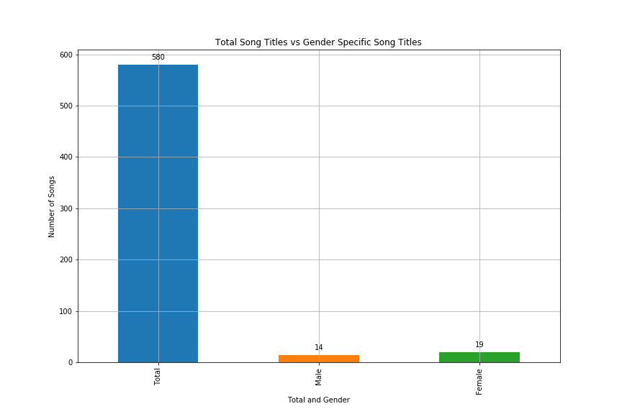
Winner = Females
But close
Song Titles | Total Number | Percent of Songs
All Songs | 580 | 100.00%
Male Songs | 14 | 2.41%
Female Songs | 19 | 3.28%

Slide 14

Solo Artist or Group ? Winner is
Hypothesis # 3:
The likelihood of solo artists making a top 10 hit is greater than the likelihood of groups making a top 10 hit.
SOLO

Slide 15
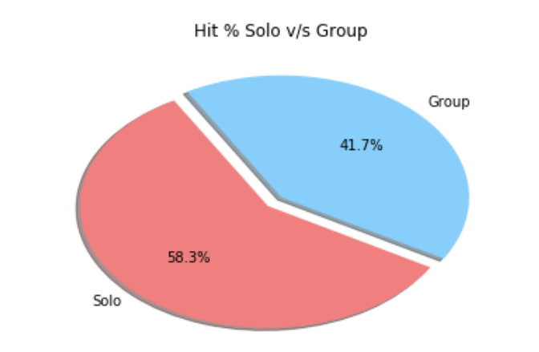
Lets talk about numbers
Solo | Group | Total
338 | 242 | 580
58% | 42 % | 100 %

Slide 16
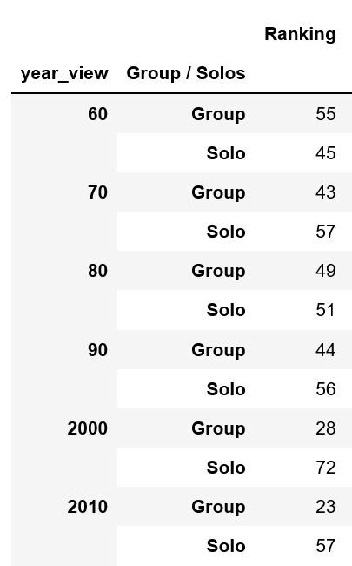
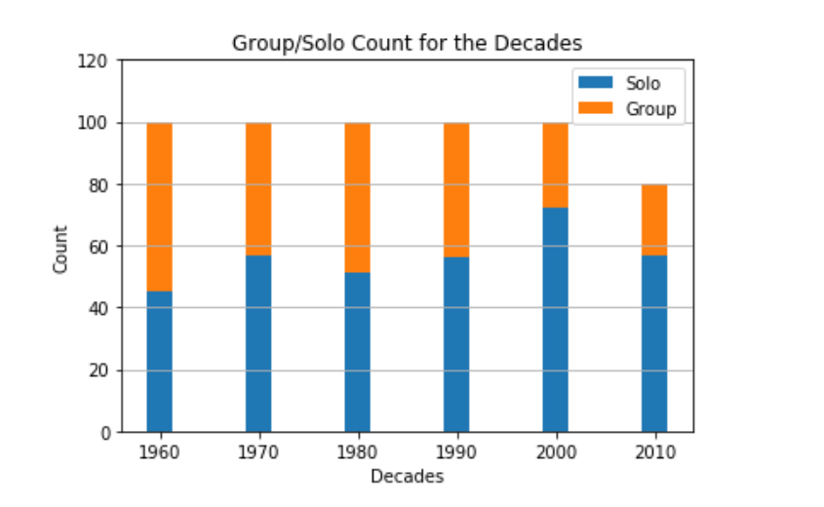
year wise winner (1960’s – 2018)

Slide 17
Summary of results
-iN ANALYZING GENDER TRENDS IN SONG TITLES, IT WAS OBSERVED THAT FEMALE WORDS APPEARED IN 3.28% OF SONG TITLES AND MALES 2.41% OF SONG TITLES
-Analyzing the overall trends of hits(Solo v/s Group), it was observed that the solo artist are having higher hits than the group.
- Year’s for Solo songs were 1972 and 2008, all the hits were from Solo Artist.
- Group Songs had maximum of 8 hits(out of 10) in 1960’s(1965, 1966, 1967 and 1969).

